Slide 1
AES & LDPC Cryptcoding
2024년 10월 7일
Su-Hak Lee, Hee-Ju Yeo
Department of Computer Engineering

Slide 2
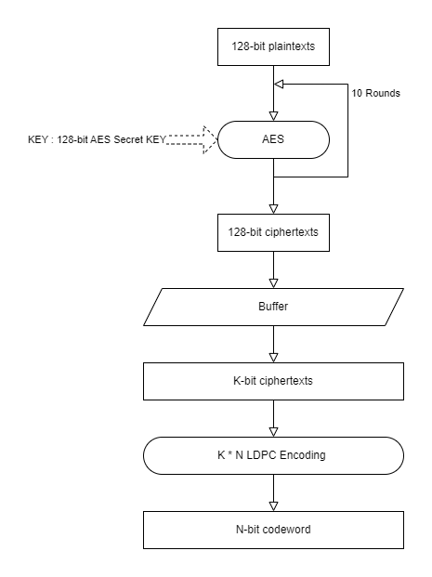
AES & LDPC

Slide 3
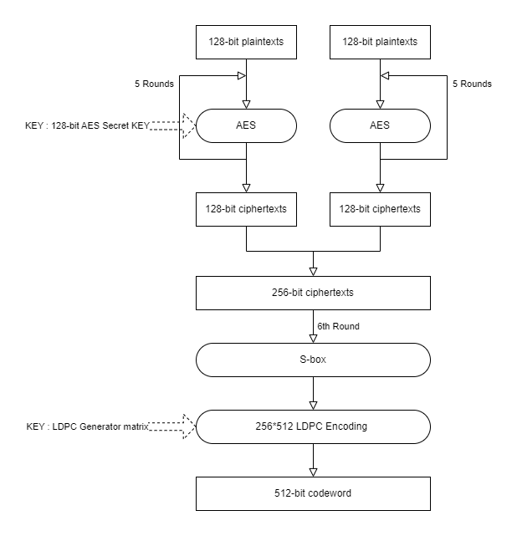
LDPC-ECC

Slide 4

Difference
AES & LDPC
LDPC-ECC

Slide 5
GOAL
Independent Keys
: 128-bit AES secret Key & 256*512 LDPC Generator matrix
⇒ related Keys
Low code rate : 1/2
⇒ Puncturing & Buffering

